Slide 1
Trees

Slide 2
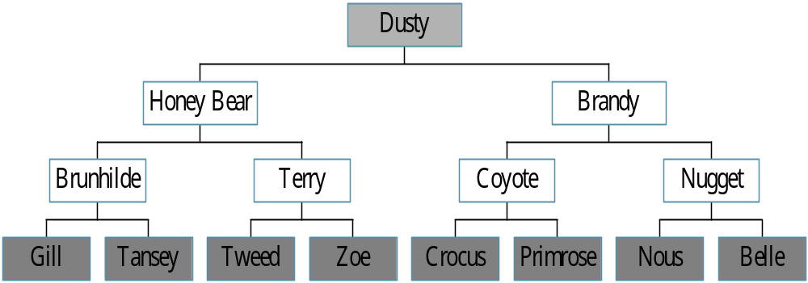
Trees
Root
leaf
CHAPTER 5

Slide 3
Definition of Tree
A tree is a finite set of one or more nodes
such that:
  There is a specially designated node called
  the root.
  The remaining nodes are partitioned into n>=0 disjoint sets T1, ..., Tn, where each of these sets is a tree.
  We call T1, ..., Tn the subtrees of the root.
CHAPTER 5

Slide 4
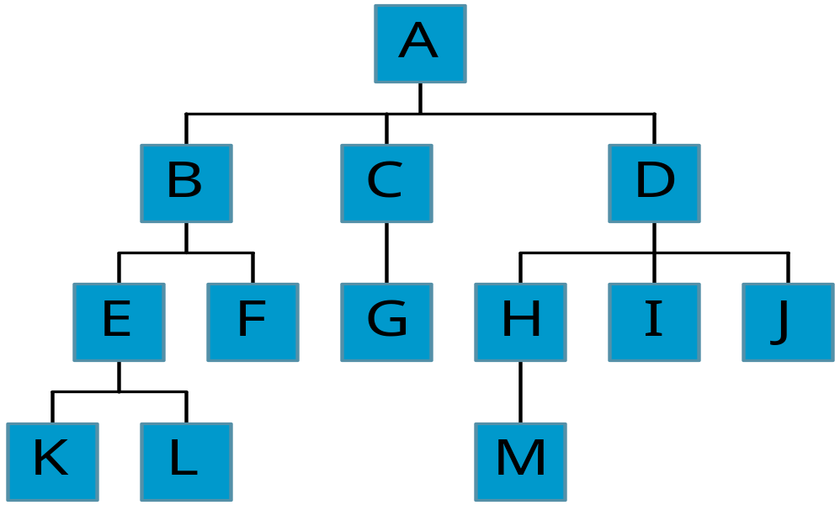
Level and Depth
node (13)
degree of a node
leaf (terminal)
nonterminal
parent
children
sibling
degree of a tree (3)
ancestor
level of a node
height of a tree (4)
Level
1
2
3
4
3
1
2
2
1
2
3
2
2
3
3
3
3
0
1
3
3
0
0
0
0
4
0
4
0
4
CHAPTER 5

Slide 5
Terminology
The degree of a node is the number of subtrees
of the node
  The degree of A is 3; the degree of C is 1.
The node with degree 0 is a leaf or terminal
node.
A node that has subtrees is the parent of the
roots of the subtrees.
The roots of these subtrees are the children of
the node.
Children of the same parent are siblings.
The ancestors of a node are all the nodes
along the path from the root to the node.
CHAPTER 5

Slide 6
Representation of Trees
List Representation
  ( A ( B ( E ( K, L ), F ), C ( G ), D ( H ( M ), I, J ) ) )
  The root comes first, followed by a list of sub-trees
data
link 1
link 2
...
link n
How many link fields are
needed in such a representation?
CHAPTER 5

Slide 7
Left Child - Right Sibling
Node structure:
data
left child
right sibling
CHAPTER 5

Slide 8
Left Child - Right Sibling
data
A
left child
right sibling
B
C
D
E
F
G
H
I
J
K
L
M
CHAPTER 5

Slide 9
Degree-Two Tree Representation
Node structure:
data
left child
right child
CHAPTER 5

Slide 10
Binary Trees
A binary tree is a finite set of nodes that is
either empty or consists of a root and two
disjoint binary trees called the left subtree
and the right subtree.
Any tree can be transformed into binary tree.
  by left child-right sibling representation
The left subtree and the right subtree are distinguished.
CHAPTER 5

Slide 11
*Figure 5.6: Left child-right child tree representation of a tree (p.191)
A
B
E
C
G
D
K
F
H
L
M
I
J

Slide 12
Abstract Data Type Binary_Tree
structure Binary_Tree(abbreviated BinTree) is
objects: a finite set of nodes either empty or
consisting of a root node, left Binary_Tree,
and right Binary_Tree.
functions:
for all bt, bt1, bt2 ∈ BinTree, item ∈ element
Bintree Create()::= creates an empty binary tree
Boolean IsEmpty(bt)::= if (bt==empty binary
tree) return TRUE else return FALSE
CHAPTER 5

Slide 13
BinTree MakeBT(bt1, item, bt2)::= return a binary tree
whose left subtree is bt1, whose right subtree is bt2,
and whose root node contains the data item
Bintree Lchild(bt)::= if (IsEmpty(bt)) return error
else return the left subtree of bt
element Data(bt)::= if (IsEmpty(bt)) return error
else return the data in the root node of bt
Bintree Rchild(bt)::= if (IsEmpty(bt)) return error
else return the right subtree of bt
CHAPTER 5

Slide 14
Samples of Trees
Complete Binary Tree
A
A
1
A
B
B
2
B
C
C
Skewed Binary Tree
3
D
E
F
G
D
4
H
I
E
5
CHAPTER 5

Slide 15
Maximum Number of Nodes in BT
The maximum number of nodes on level i of a binary tree is 2^{i-1}, i>=1.
The maximum nubmer of nodes in a binary tree
of depth k is 2^{k}-1, k>=1.
i-1
CHAPTER 5

Slide 16
Relations between Number of
Leaf Nodes and Nodes of Degree 2
For any nonempty binary tree, T, if n0 is the
number of leaf nodes and n2 the number of nodes
of degree 2, then n0=n2+1
CHAPTER 5

Slide 17
Full BT VS Complete BT
A full binary tree of depth k is a binary tree of
depth k having 2 -1 nodes, k>=0.
A binary tree with n nodes and depth k is
complete iff its nodes correspond to the nodes numbered from 1 to n in the full binary tree of
depth k.
k
A
A
B
C
B
C
D
E
F
G
D
E
F
G
H
H
I
J
K
L
M
N
O
I
Complete binary tree
Full binary tree of depth 4
CHAPTER 5

Slide 18
Binary Tree Representations
If a complete binary tree with n nodes (depth =
log n + 1) is represented sequentially, then for
any node with index i, 1<=i<=n, we have:
  parent(i) is at i/2 if i!=1. If i=1, i is at the root and
  has no parent.
  left_child(i) is at 2i if 2i<=n. If 2i>n, then i has no
  left child.
  right_child(i) is at 2i+1 if 2i +1 <=n. If 2i +1 >n,
  then i has no right child.
CHAPTER 5

Slide 19
BT: Array Representation
[1]
[2]
[3]
[4]
[5]
[6]
[7]
[8]
[9]
A
B
C
D
E
F
G
H
I
(1) waste space
(2) insertion/deletion
problem
A
[1]
[2]
[3]
[4]
[5]
[6]
[7]
[8]
[9]
.
[16]
A
B
--
C
--
--
--
D
--
.
E
B
A
C
B
C
D
D
E
F
G
E
H
I
CHAPTER 5

Slide 20
BT: Linked Representation
typedef struct node *tree_pointer;
typedef struct node {
int data;
tree_pointer left_child, right_child;
};
data
left_child
data
right_child
left_child
right_child
CHAPTER 5

Slide 21
Give Linked Tree Representation
Complete Binary Tree
A
A
1
A
B
B
2
B
C
C
Skewed Binary Tree
3
D
E
F
G
D
4
H
I
E
5
CHAPTER 5

Slide 22
Binary Tree Creation
typedef struct node
{
int data;
struct node *lchild;
struct node *rchild; } *NODE;
CHAPTER 5

Slide 23
Binary Tree Creation..
NODE Create_Binary_Tree()
{ NODE temp;
int ele;
printf("Enter the element to inserted (-1 for no data):");
scanf("%d",&ele);
if(ele==-1)
return NULL;
CHAPTER 5

Slide 24
Binary Tree Creation…
temp=(NODE*)malloc(sizeof(struct node));
temp->data=ele;
printf("Enter lchild child of %d:\n",ele);
temp->lchild=Create_Binary_Tree();
printf("Enter rchild child of %d:\n",ele);
temp->rchild=Create_Binary_Tree ();
return temp;
}
CHAPTER 5

Slide 25
Binary Tree Traversals
Let L, V, and R stand for moving left, visiting
the node, and moving right.
There are six possible combinations of traversal
  LVR, LRV, VLR, VRL, RVL, RLV
Adopt convention that we traverse left before
right, only 3 traversals remain
  LVR, LRV, VLR
  inorder, postorder, preorder
CHAPTER 5

Slide 26
Arithmetic Expression Using BT
+
inorder traversal
A / B * C * D + E
infix expression
preorder traversal
+ * * / A B C D E
prefix expression
postorder traversal
A B / C * D * E +
postfix expression
level order traversal
+ * E * D / C A B
*
E
*
D
/
C
A
B
CHAPTER 5

Slide 27
Inorder Traversal (recursive version)
void inorder(tree_pointer ptr)
/* inorder tree traversal */
{
if (ptr) {
inorder(ptr->left_child);
printf(“%d”, ptr->data);
indorder(ptr->right_child);
}
}
A / B * C * D + E
CHAPTER 5

Slide 28
Trace Operations of Inorder Traversal
Call of inorder | Value in root | Action
CHAPTER 5

Slide 29
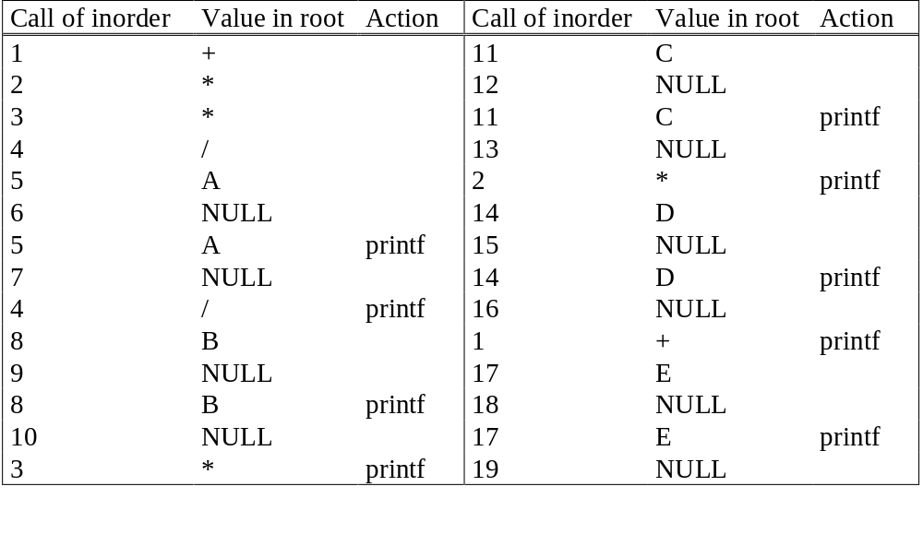
Trace Operations of Inorder Traversal
CHAPTER 5

Slide 30
Preorder Traversal (recursive version)
void preorder(tree_pointer ptr)
/* preorder tree traversal */
{
if (ptr) {
printf(“%d”, ptr->data);
preorder(ptr->left_child);
predorder(ptr->right_child);
}
}
+ * * / A B C D E
CHAPTER 5

Slide 31
Postorder Traversal (recursive version)
void postorder(tree_pointer ptr)
/* postorder tree traversal */
{
if (ptr) {
postorder(ptr->left_child);
postdorder(ptr->right_child);
printf(“%d”, ptr->data);
}
}
A B / C * D * E +
CHAPTER 5

Slide 32
Iterative Inorder Traversal
(using stack)
void iter_inorder(tree_pointer node)
{
int top= -1; /* initialize stack */
tree_pointer stack[MAX_STACK_SIZE];
for (;;) {
for (; node; node=node->left_child)
push(&top, node);/* add to stack */
node= pop(&top);
/* delete from stack */
if (!node) break; /* empty stack */
printf(“%d”, node->data);
node = node->right_child;
}
}
CHAPTER 5

Slide 33
Level Order Traversal
(using queue)
void level_order(tree_pointer ptr)
/* level order tree traversal */
{
int front = rear = 0;
tree_pointer queue[MAX_QUEUE_SIZE];
if (!ptr) return; /* empty queue */
addq(front, &rear, ptr);
for (;;) {
ptr = deleteq(&front, rear);
CHAPTER 5

Slide 34
if (ptr) {
printf(“%d”, ptr->data);
if (ptr->left_child)
addq(front, &rear,
ptr->left_child);
if (ptr->right_child)
addq(front, &rear,
ptr->right_child);
}
else break;
}
}
+ * E * D / C A B
CHAPTER 5

Slide 35
Iterative Preorder Traversal
(using stack)
1) Create an empty stack Stack and push root node to stack.
2) Do following while Stack is not empty.
a) Pop an item from stack and print it.
b) Push right child of popped item to stack
c) Push left child of popped item to stack
CHAPTER 5

Slide 36
Iterative Preorder Traversal
(using stack)
void iter_preorder(tree_pointer root)
{
int top= -1; /* initialize stack */
tree_pointer stack[MAX_STACK_SIZE];
tree_pointer node;
if (!root) return;
push(&top, root);
while(!IsEmpty(&top))
{ node = pop(&top);
printf(“%d”, node->data);
if(node->right_child)
push(&top,node->right_child);
if(node->left_child)
push(&top,node->left_child);
}
}
CHAPTER 5

Slide 37
Arithmetic Expression Using BT
+
inorder traversal
A / B * C * D + E
infix expression
preorder traversal
+ * * / A B C D E
prefix expression
postorder traversal
A B / C * D * E +
postfix expression
level order traversal
+ * E * D / C A B
*
E
*
D
/
C
A
B
CHAPTER 5

Slide 38
Postorder Traversal (recursive version)
void postorder(tree_pointer ptr)
/* postorder tree traversal */
{
if (ptr) {
postorder(ptr->left_child);
postdorder(ptr->right_child);
printf(“%d”, ptr->data);
}
}
A B / C * D * E +
CHAPTER 5

Slide 39
Iterative Postorder Traversal
(using stack)
CHAPTER 5

Slide 40
postfix Arithmetic Expression
+
*
E
*
D
A B / C * D * E +
postfix expression
Trace iterative postorder
traversal
/
C
A
B
CHAPTER 5

Slide 41
Postfix expression: Create BT and Evaluate
(using stack)
Create BinaryTree:
For constructing expression tree we use a stack.
Loop through input expression and do following for every character.
1) If character is operand push that into stack
2) If character is operator pop two values from stack make them its child and push current node again.
At the end only element of stack will be root of expression tree.
CHAPTER 5

Slide 42
Postfix expression: Create BT and Evaluate
(using stack)
Create BinaryTree:
node* create(char str[])
{node *temp: Stack S; S.top=-1; char c; int i=0;
While((c=str[i++]!=‘\0’){
temp = (node*) malloc(sizeof(node));
temp->data=c; temp->left=temp->right=NULL;
if (isalnum(c) push(&s, temp);
else { temp->right = pop(&s);
temp->left = pop(&s);
push(&s, temp);}}
return pop(&s);
}
CHAPTER 5

Slide 43
Postfix expression: Create BT and Evaluate
(using stack)
Evaluate:
int eval(node* root)
{ switch(root->data){
case ‘+’: return eval(root->left)+ eval(root->right);
case ‘-’: return eval(root->left)- eval(root->right);
case ‘*’: return eval(root->left)* eval(root->right);
case ‘/’: return eval(root->left)/ eval(root->right);
case ‘^’: return eval(root->left)^ eval(root->right);
default: return(root->data – ‘0’);
}
}
CHAPTER 5

Slide 44
Postfix expression: Create BT and Evaluate
(using stack)
Evaluate:
create and evaluate postfix expression: 6 3 2 – 5 * + 2 /
CHAPTER 5

Slide 45
postfix Arithmetic Expression
+
*
E
*
D
A B / C * D * E +
postfix expression
Create BT and Evaluate
/
C
A
B
CHAPTER 5

